Slide 1

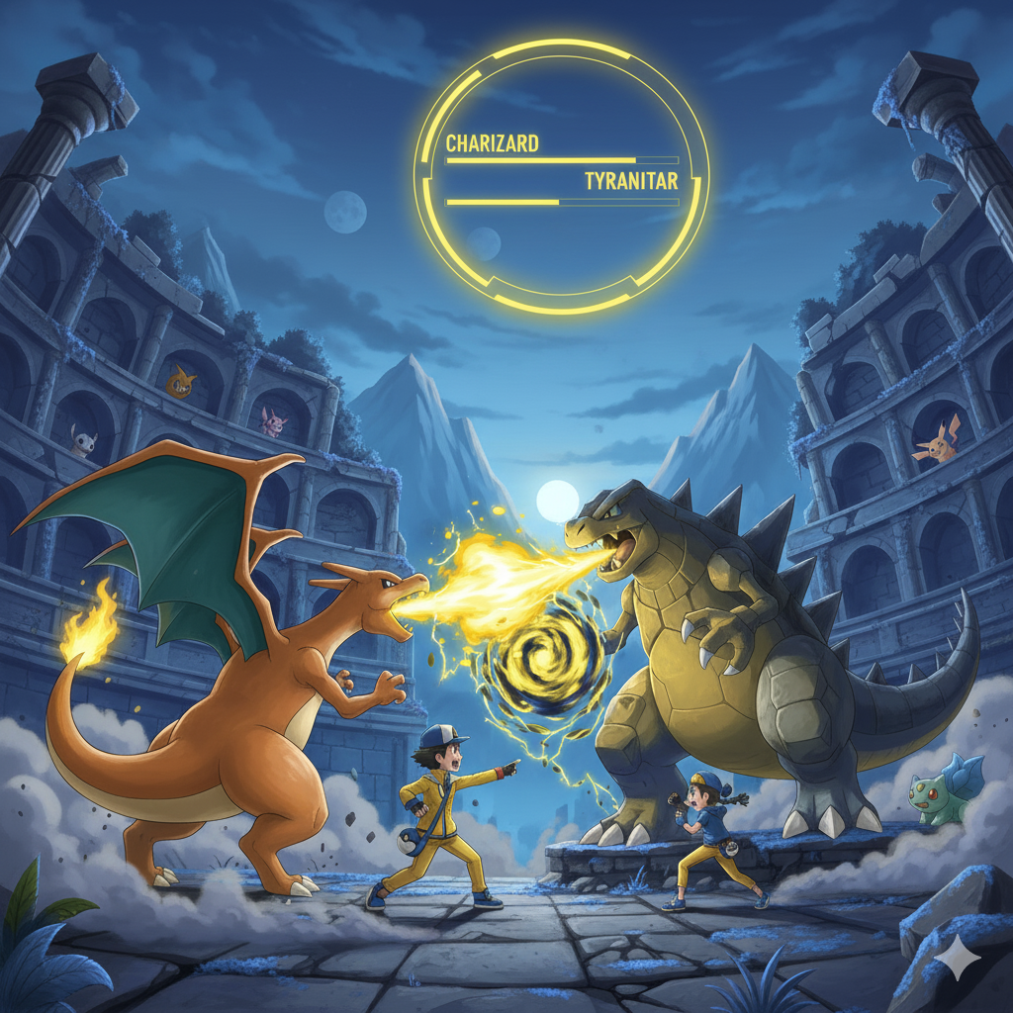

POKEMON
API
Presented by: Sachen Pather

Slide 2
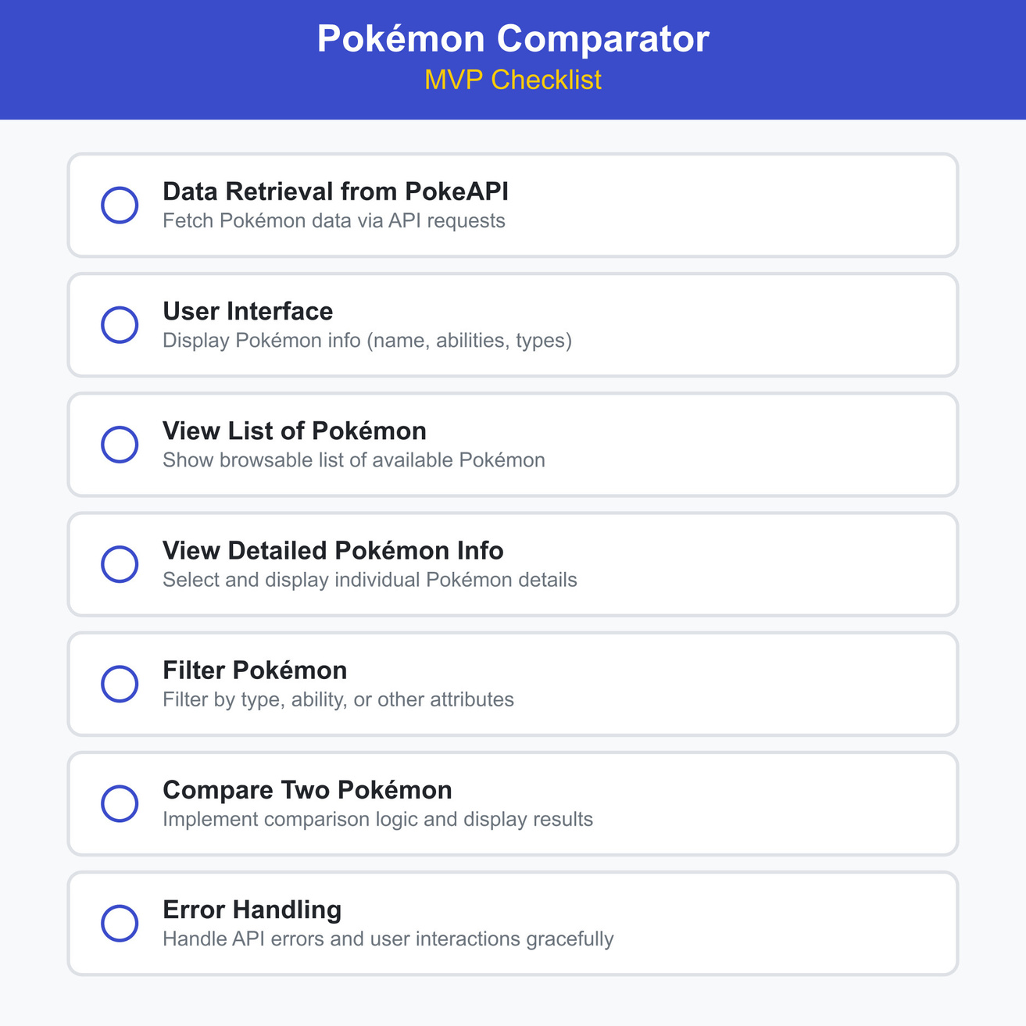
Goal
Build a Pokémon information system that retrieves data from PokeAPI and enables users to view, filter, and compare Pokémon through a custom battle logic.
Objectives
Retrieve data from PokeAPI, create a user interface for viewing and filtering Pokémon, implement custom battle comparison logic, handle errors gracefully, and optionally add caching to improve performance

Slide 3

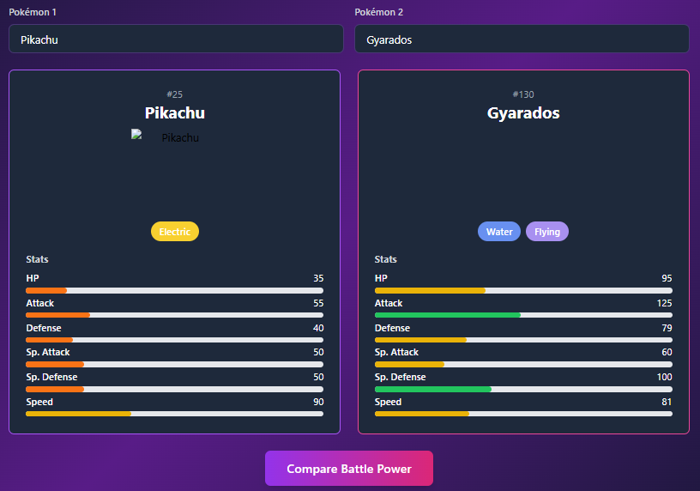


THE CHALLENGE

Slide 4
BATTLE ALGORITHM DESIGN
FLOWCHART OF PHASES FOR DETERMINING VICTORS
01
02
03
04
Instant win conditions
Type immunities
Type effectiveneess calculations
Ability Modifiers
05
06
07
Damage calculations
Turns to knock out
Weighted score from tie break

Slide 5
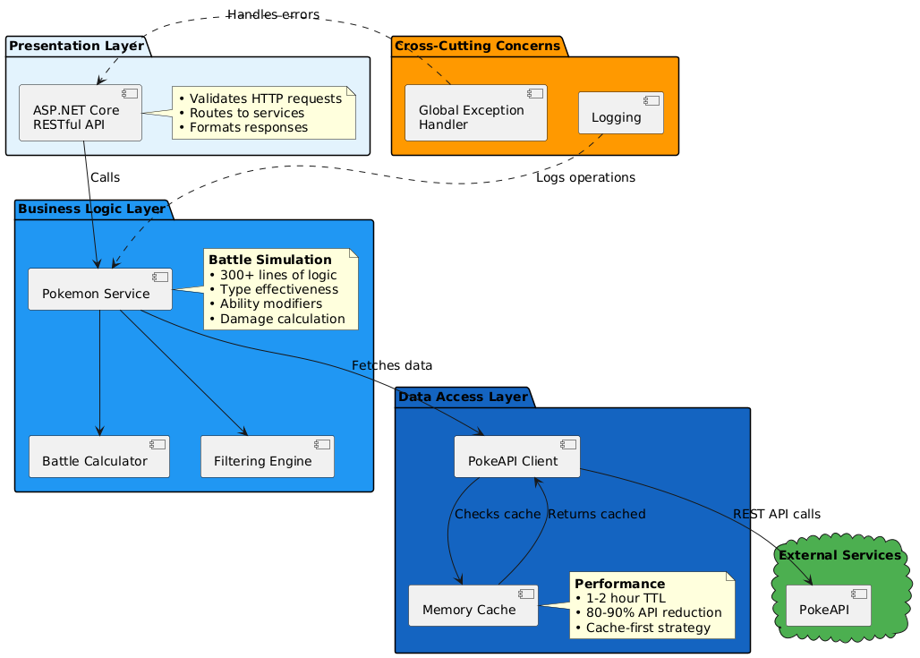
ARCHITECTURAL DESIGN
SOLID Principles
Complex Code, maintainable codebase

Slide 6

SYSTEM FLOW
List of all pokemon
Search for specific pokemon
Ability and type filters
Complex filter system
Battle comparison

Slide 7

DEMO

